Slide 1





Wicomico County
Building Bridges, Building Community
Social Media as a Service

Slide 2
Social Media as a Service
Beyond a Communications and Marketing Tool:
Public Engagement/Policy Feedback
Service Improvement and Response
Internal Operations
Economic Development
Emergency Management
Notes:
More and more, governments are turning to social media not simply to communicate or push-out information but to engage constituencies and improve the provision of services. It allows for all levels of government to be more transparent. Through the use of social media, the public can discuss the county budget, weigh in on public policy questions, report a pot hole or find out about an emergency – often by using their cell phones or tablets.

Slide 3
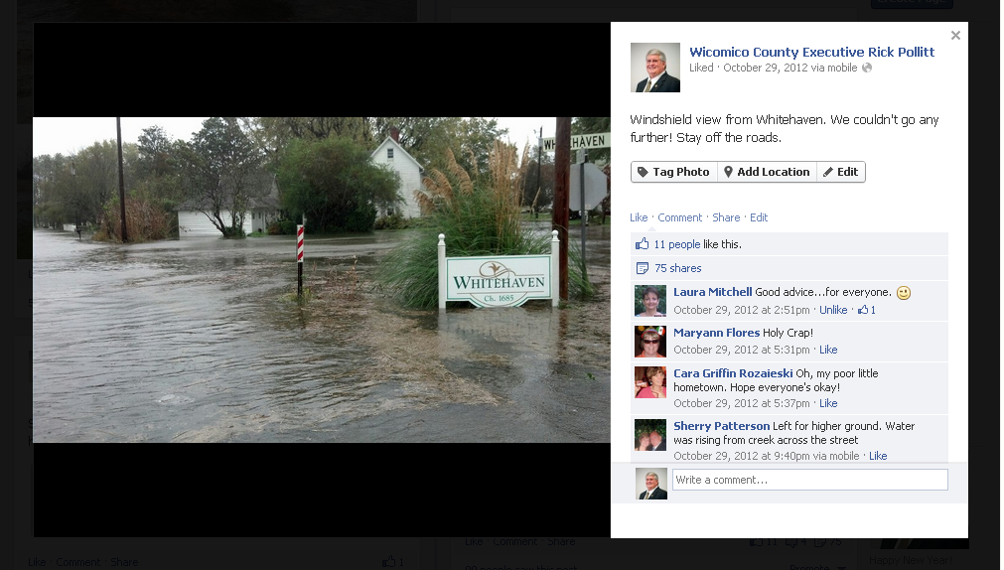
Challenge: Hurricane Sandy
Notes:
Since we began actively using Facebook in 2012 – Hurricane Sandy was our first major emergency

Slide 4
Social Media as a Service
Emergency Management – Hurricane Sandy
A vital opportunity to provide information in places where people look for them:
Direct communication with constituents, No filter
Speed of message delivery, Real-time
Provide accurate information
Connect residents to resources and to each other
Educate the public on how the county functions and responds during storms/major events
Key Messages: Care, Concern and Cooperation
Hootsuite: Facebook, Twitter, LinkedIn
YouTube
Notes:
A great way to stay connected with your community is to interact with them using the channels they frequent the most. In Wicomico County, approximately 76,000 residents of the nearly 100,000 utilized Facebook. Social media gives us the opportunity to share information where our citizens are rather than having them come to us.
Whether or not your county is utilizing social media for emergency management communications, your constituents are searching for this information online. Our emergency management personnel are the trained experts and have the wherewithal to direct our citizens with timely and accurate information .

Slide 5
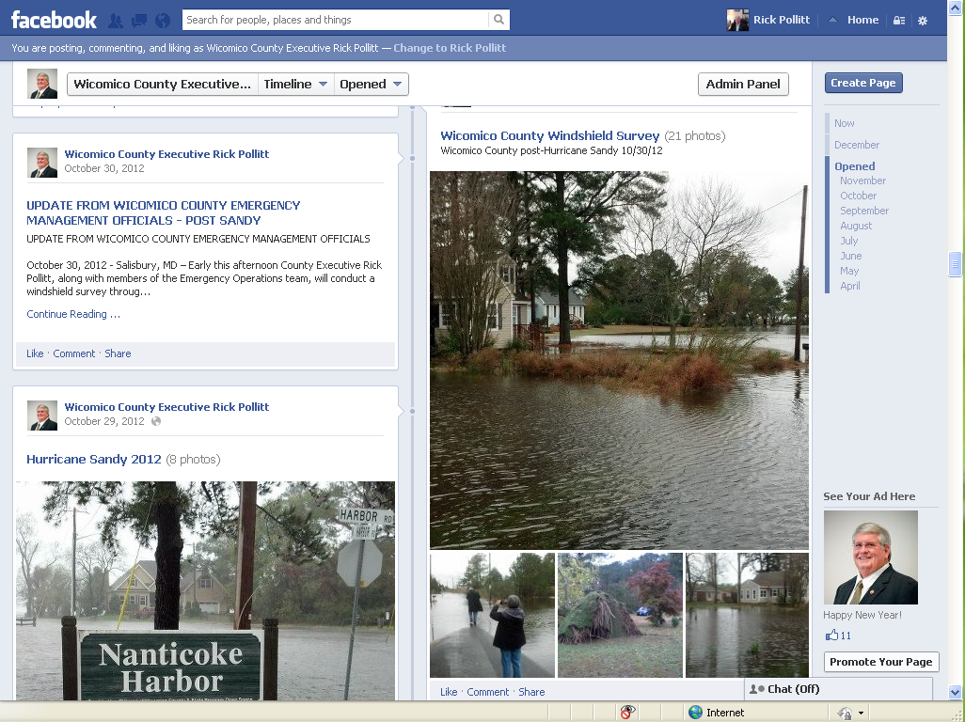
Facebook
Approximately 76% of residents in Wicomico County are using Facebook
Notes:
76% of citizens in Wicomico County are using facebook

Slide 6
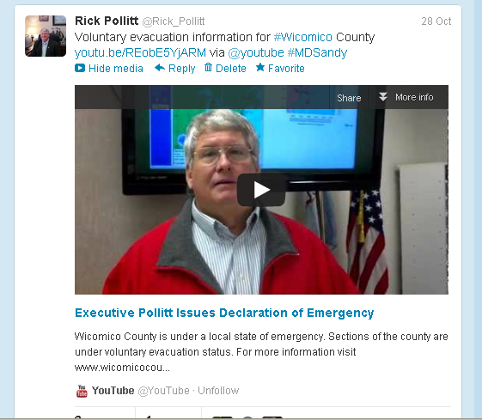
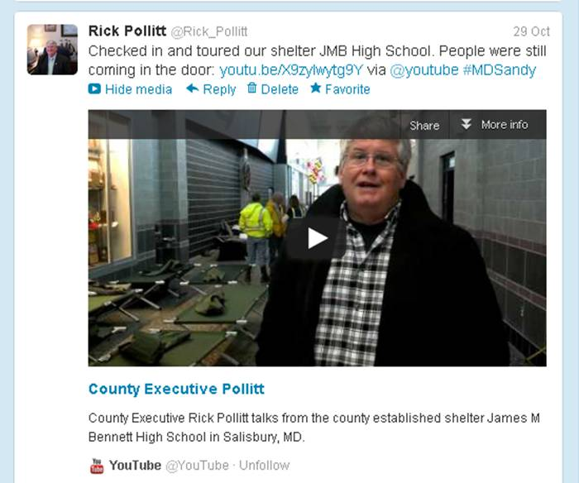
Twitter & YouTube
Twitter: People sent more than 20 million tweets about the storm between Oct 27 & Nov 1. Terms tracked: #Sandy, #Hurricane

Slide 7
Emergency Communications
Conduct emergency communications and issue warnings
Declaration of Emergency, instructions for residents/affected areas, weather status up-dates
Web site, Facebook, Twitter, Videoblog/YouTube
Feed and direct news media
Using social media to receive victims requests for assistance
Rescue assistance, shelter operations information
Notes:
Communicate across multiple platforms – including through the Communicator – the upgraded Reverse 911 system.

Slide 8
Emergency Communications
Monitoring user activities and postings to establish situational awareness
Flooding, power outages, road openings/closures
Hootsuite’s dashboard view,
Twitter search menu,
Google Alerts/Reader,
Facebook search
Using uploaded images to create damage estimates
Notes:
Social media monitoring – the act of listening to online conversations and discussions to learn what is being said, by whom and to whom in order to improve your own social media presence

Slide 9
Emergency Communications
Key Messages or Themes: Care, Concern, Cooperation
First priority is the safety of our residents
We have a plan, we’re prepared and as ready as we can be
Cooperating with local emergency responders
We are doing the best we can under the circumstances
Help us to communicate with loved ones about the status/location of our residents -- through RTs, Shares
Correct misinformation
Notes:
Help us to communicate with loved ones by sharing, re-tweeting what has been posted.
Correct misinformation – we had to deal with misinformation about the location of our shelter. People were communicating a different location which had the potential of causing safety issues for those given wrong info; a neighboring state had to deal with a photo-shopped image of a bridge that had been wiped out by the hurricane.

Slide 10
Best Practices
Identify responsibility for defining the message and relaying information
Place accuracy before speed
Spur action when needed
Test your strategy before a crisis hits
Seize opportunities to create something positive from an emergency situation
Prepare to use social media more
Notes:
Identify responsibility: The Public Information office is responsible for posting and updating content; scanning and monitoring social media for inaccurate or misinformation. The person or staff members you choose need to understand their role as a communicator and spokesperson for the county and the impact this online exchange can have.
During crisis situations it is extremely important to quickly post information but it’s even more crucial that the information is accurate. I would hope that we prefer to sacrifice speed in the name of accuracy
It’s important to alert residents in a clear and consistent manner when you need them to take action in an emergency situation. We encouraged our social media followers to re-tweet or re-post the county’s message to help ensure that accurate information reaches more people
Test: A crisis is not the appropriate time to launch new social media activities. Counties should already be active and ready to provide residents with the info they need to stay safe.
Seize: We learned that this opportunity can bring out the best in people. It provided an opportunity to grow and strengthen citizen engagement, public leadership and improve community.
Use: We need to be prepared now, recognize and prepare for a continued increase in social media usage

Slide 11
Choosing Social Media Platforms
Some tips
Determine your goals
Centralized vs. Decentralized Social Media Management
It’s okay to start small
It’s better to do 1 or 2 very well, than do several poorly
Facebook and Twitter are the most common for government…followed by YouTube and Pinterest
Monitoring is KEY
Notes:
The reason that this is important is because it takes an investment in time. You have to be participate and you have to responsive. It would be better not to have a social media presence than to have a page but only post or tweet inconsistently. Social media monitoring needs to be on an hourly or ‘real time’ basis for it to be effective.

Slide 12
Wicomico County
Tamara Lee-Brooks
Public Information Officer
tleebrooks@wicomicocounty.org
410-548-4801
Facebook.com/CountyExecPollitt
@Rick_Pollitt
Youtube.com/WicomicoCountyExec

