Slide 1

Charles County Government
Using Technology to Connect Citizens with Local Government

Slide 2
Mission Statement
The mission of Charles County Government is to provide our citizens the highest quality service possible in a timely, efficient, and courteous manner. To achieve this goal, our government must be operated in an open and accessible atmosphere, be based on comprehensive long and short-term planning, and have an appropriate managerial organization tempered by fiscal responsibility.

Slide 3

What’s in Our “Tech” Toolbox?
Website
Emergency Alert System (CNS)
E-news
CCGTV – Cable Television
Podcasts
Social Media

Slide 4
CCGTV News Show

Slide 5
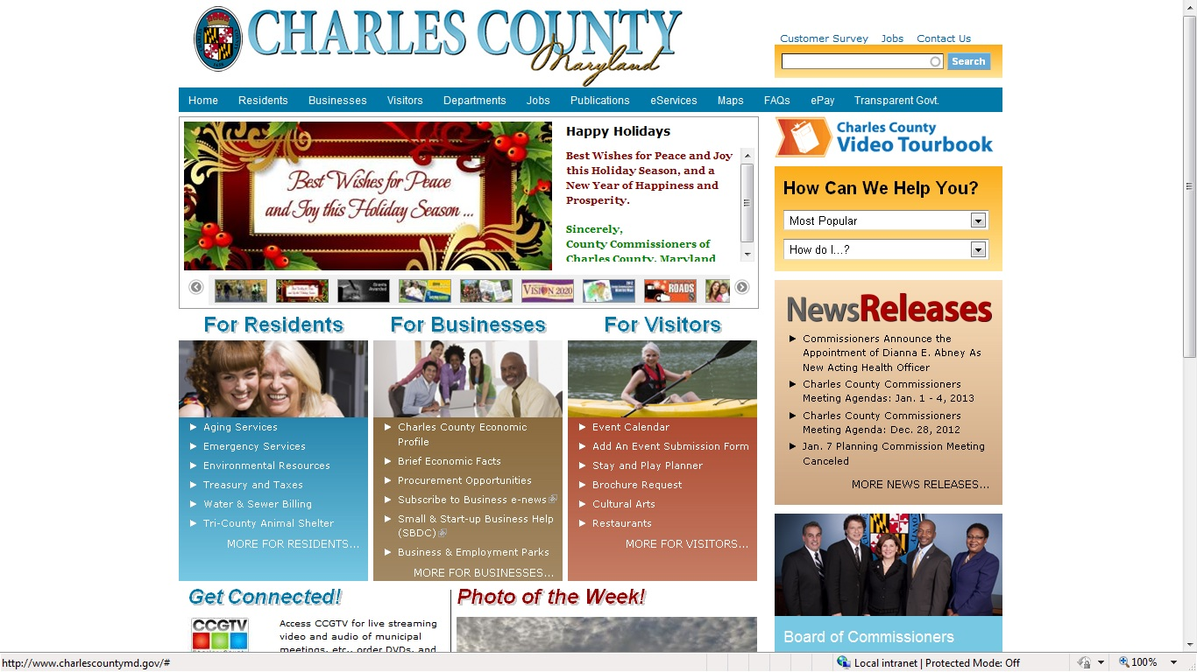
www.CharlesCountyMD.gov

Slide 6
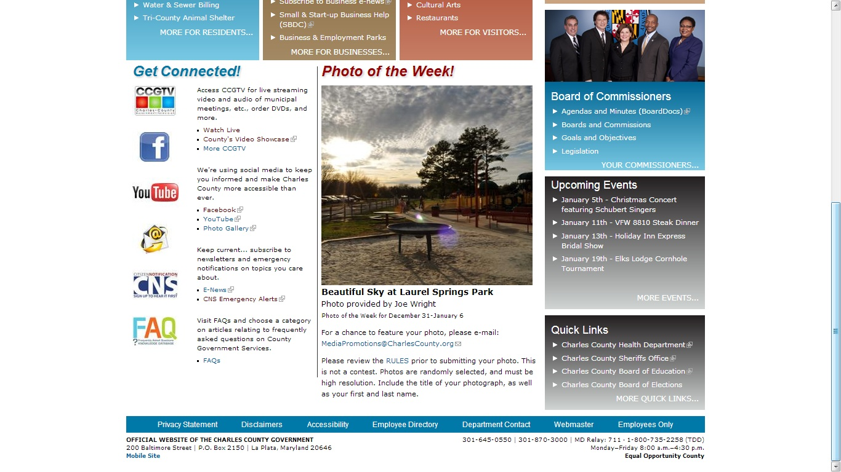
www.CharlesCountyMD.gov

Slide 7







Current Portfolio

Slide 8
Why Social Media?
Americans spend more time online on social media sites than any other activity.
Social media sites dominate website rankings.
Social media reaches audiences that do not consume traditional news media.
We need to reach citizens in multiple ways.

Slide 9
Some Interesting Statistics…
Monthly active users on Facebook now total nearly 850 million. (source: Jeff Bullas)
23 percent of Facebook's users check their account five or more times daily. (source: Socialnomics)
More than one million websites have integrated with Facebook in various ways. (source: Uberly)

Slide 10
And a Couple More…
80 percent of social media users prefer to connect with brands through Facebook. (source: Business2Community)
Facebook is the most visited social network in the United States.

Slide 11
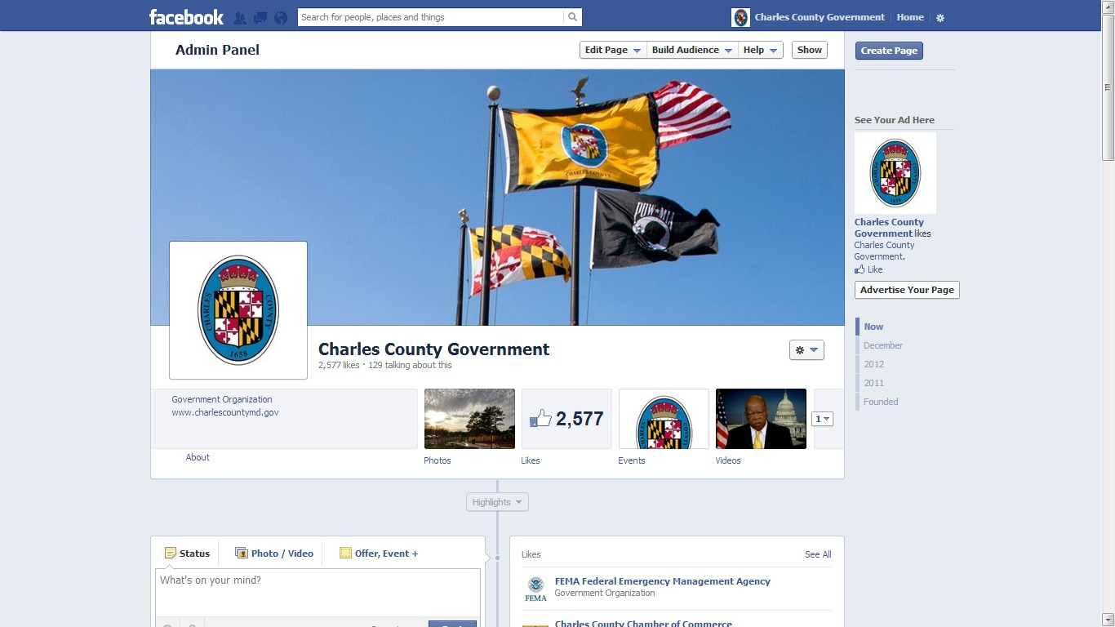
www.Facebook.com/CharlesCounty

Slide 12
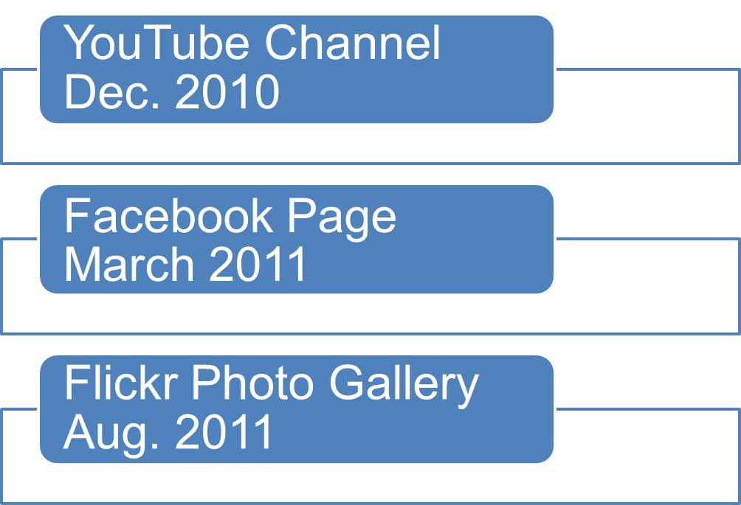
The Evolution of Social Media…

Slide 13

How Did We Get Started?
Request from Commissioners to research options
Desire by media team to increase outreach to general public, especially during emergencies

Slide 14
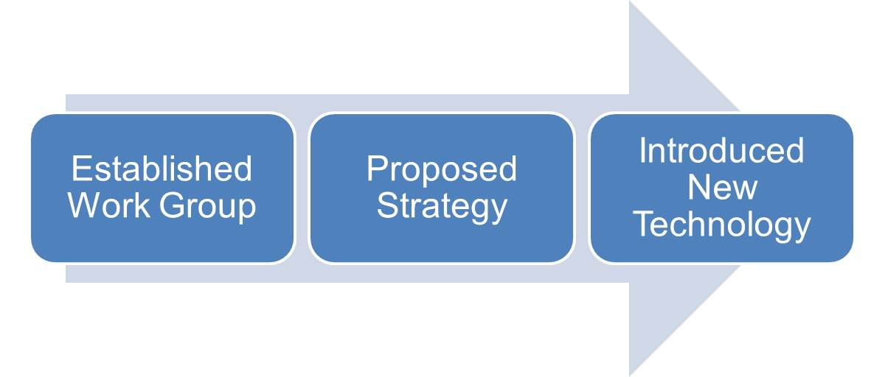
Social Media Work Group – First met in 2010; each Dept. represented
Proposed multi-phase social media strategy
Review and evaluate current efforts

Slide 15
Policy Development
Policy language added to IT policy
Needed more comprehensive policy
Draft Social Media Use policy presented to Commissioners Dec. 2012
Approval pending

Slide 16
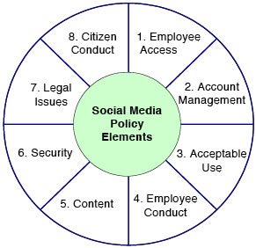
Source: Center for Technology in Government

Slide 17
Challenges/Lessons Learned
Buy-in from senior staff
Fear of negative posts or criticism
Managing multiple social media sites with limited staff resources
Unified presence vs. individual department identities
Monitoring and content are essential to success

Slide 18
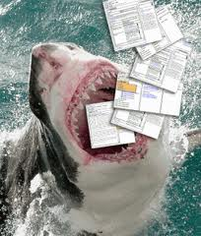
Feeding the Beast
Commissioner news and events
Water service disruptions
Road closures
Public safety messages
Human interest articles
Local events
Job openings
Meeting notices and cancellations
Animals available for adoption
Photo of the week
Videos
Lowering of the flag announcements
Photos

Slide 19





The Future?

Slide 20





Crystal N. Hunt
Public Information Officer
Office: 301-645-0580
Email: HuntC@CharlesCounty.org
Web: www.CharlesCountyMD.gov
www.Facebook.com/CharlesCounty
YouTube: CCGTVCommissioners
Flickr: Charles County Government
Mission Statement
The mission of Charles County Government is to provide our citizens the highest quality service possible in a timely, efficient, and courteous manner. To achieve this goal, our government must be operated in an open and accessible atmosphere, be based on comprehensive long- and short-term planning, and have an appropriate managerial organization tempered by fiscal responsibility.
Vision Statement
Charles County is a place where all people thrive and businesses grow and prosper; where the preservation of our heritage and environment is paramount, where government services to its citizens are provided at the highest level of excellence; and where the quality of life is the best in the nation.

