Slide 1

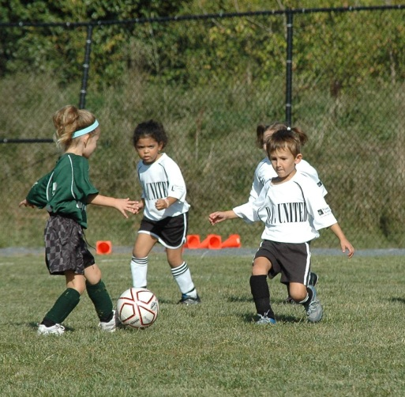
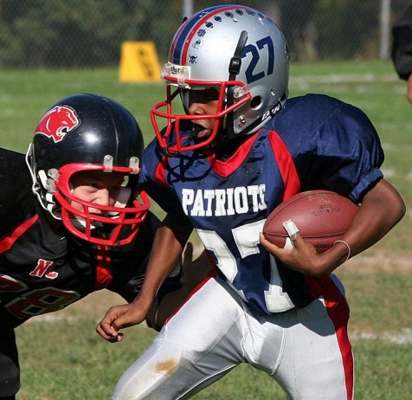
Partnering for Successful Sports Delivery

Slide 2
Partnering for Successful Sports Delivery
1960’s – One option – All Volunteers
2012 – Many options to meet various goals of organizations and Recreation & Parks
Notes:
In the early days of sports in Howard County, it was an all volunteer army, so to speak. And they did a great job. But over the last 20 years or so it has become increasingly difficult for parent run organizations to survive without professional and/or administrative assistance. Equipment has become expensive, participation is greater and “child custodial” expectations have risen. Add to this the IRS accountability, increased focus on pedophiles, and other risks of liability to coaches and administrators and the perfect storm begins to form for a strong community based desire for us to lead. An added advantage was the support and recognition from county officials that to best protect the County interests we had to be in control.

Slide 3
Why So Many?
Evolved as new leagues developed
Department of Recreation & Parks found different ways to provide and insure service
Protect resources
Notes:
We liked the high school sports model for regulatory control and good sportsmanship and we wanted to be viewed as the experts in providing these programs. Growth was rapid and not every league or organization wanted the same thing. Some were more sophisticated than others, had stronger treasuries and more consistent leadership.

Slide 4
“We’re the government and we’re here to help”.
Notes:
We began to demonstrate the benefits of having our department over see the delivery system. We can bring top of the line facilities to the table, we can purchase equipment and supplies at gov’t bid rates, we can store and distribute equipment, we can insure consistent field conditions and equitable allocation of resourses, we can insure volunteer training is current and consistent and we can provide liability insurance for volunteers registerd under our program.

Slide 5
GoodSport Guiding Principles
Athletes First
Not “Us and Them”
It’s just a game
Fun First, them development
Better Skill, Greater enjoyment
Risk Management
Notes:
The foundation of all of this is based on a “GoodSport” philisophy

Slide 6
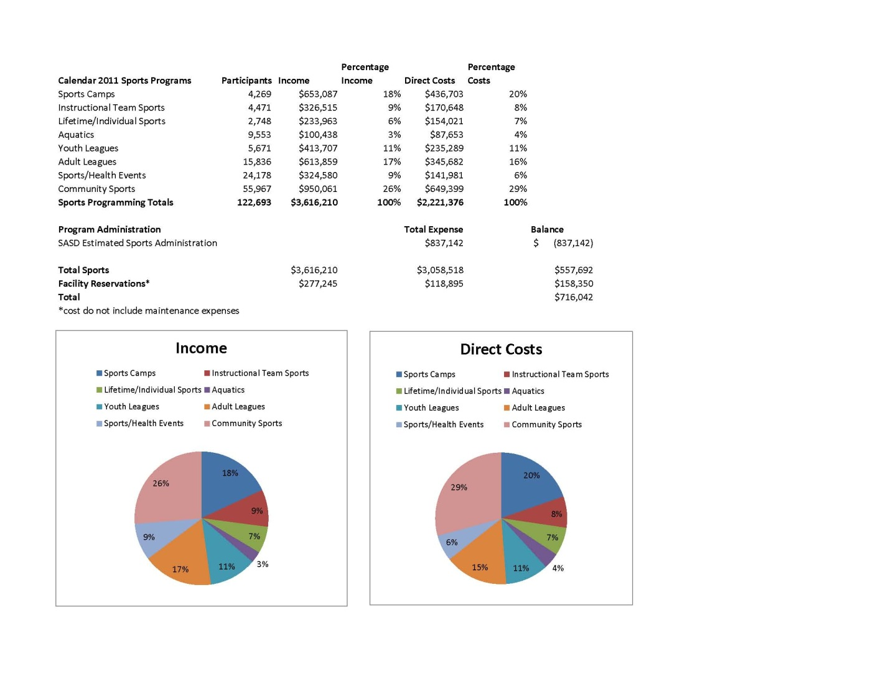
Financially Sustainable
Notes:
We need to show the program as self sustaining so we run it like a business to cover basic administrative costs and overhead and the maintenance value.

Slide 7
Delivery Options
1 | 2 | 3 | 4 | 5 | 6
Least County Control |  |  |  |  | Most County Control
Semi-Autonomous Organization | Volunteer Sports Organization contracts for HCRP Services | HCRP Franchise Leagues | HCRP Contracts Volunteer Sports Organizations for Services | HCRP Program with Advisory Board | HCRP Program
1 | 2 | 3 | 4 | 5 | 6
Least County Control |  |  |  |  | Most County Control
*See handout for details

Slide 8
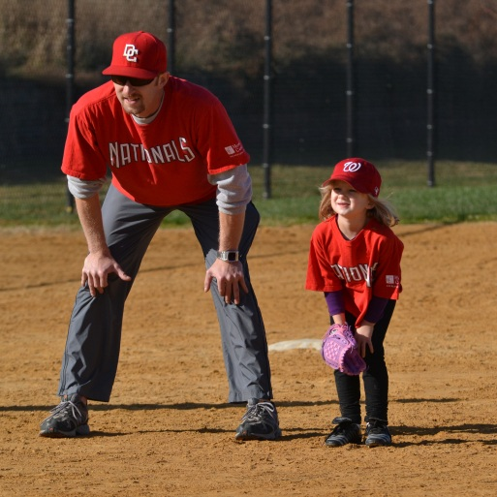
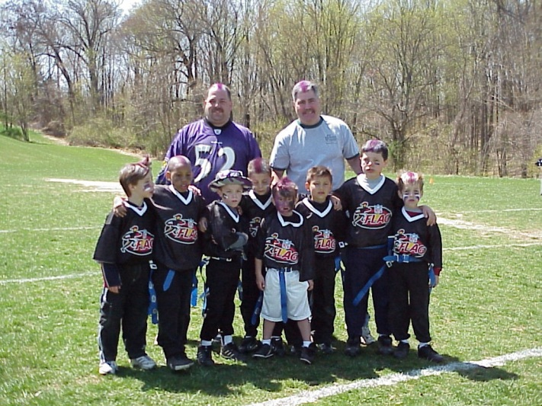
Volunteers
Volunteer hours value to County
2,007 coaches volunteered 79,666 hours during FY ‘11.
The dollar value, according to the Independent Sector is $22.32 per hour so the total is $1,778,145.00 for 79,666 hours of service.

Slide 9
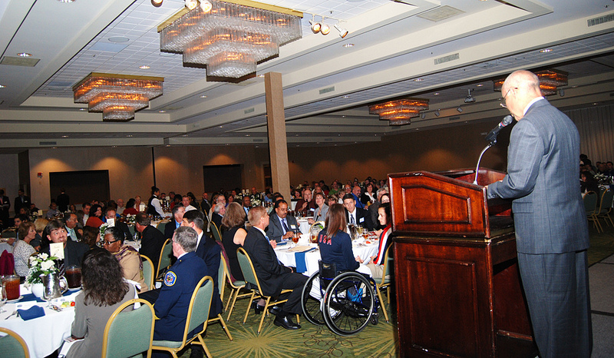
Celebration of Sports Hall of Fame
Notes:
600 people attend. Brings the entire sports community together.

Slide 10
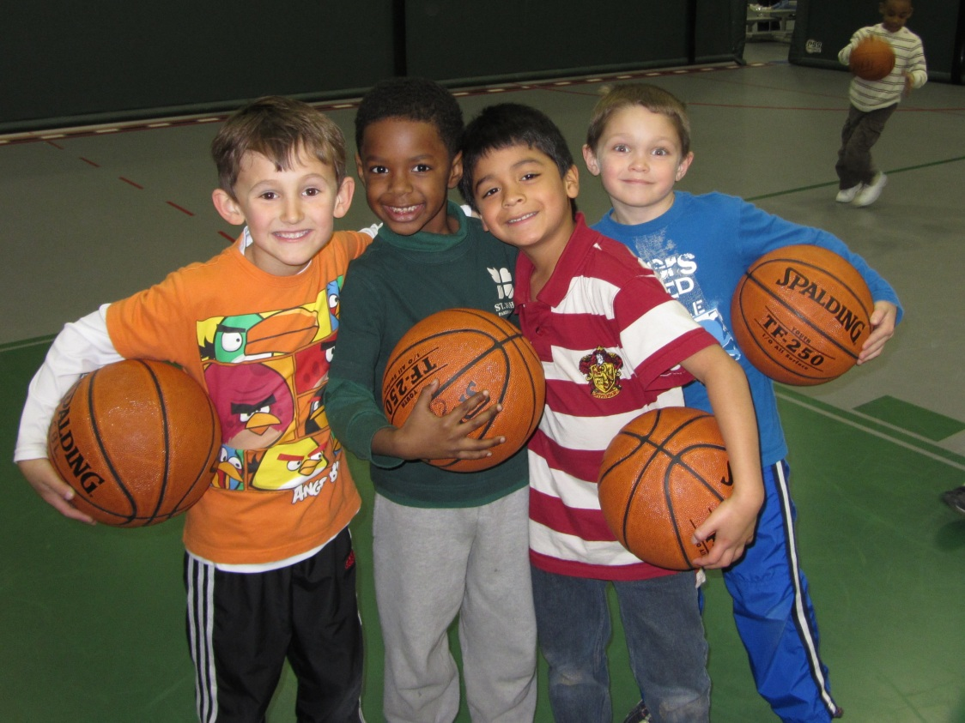
Good Sports and Happy Kids
Notes:
And of course it’s all about the kids!

