Slide 1

Maryland’s Own Fiscal Cliff
Growing
Gone!
Growing

Slide 2

Trades
Offsets

Slide 3
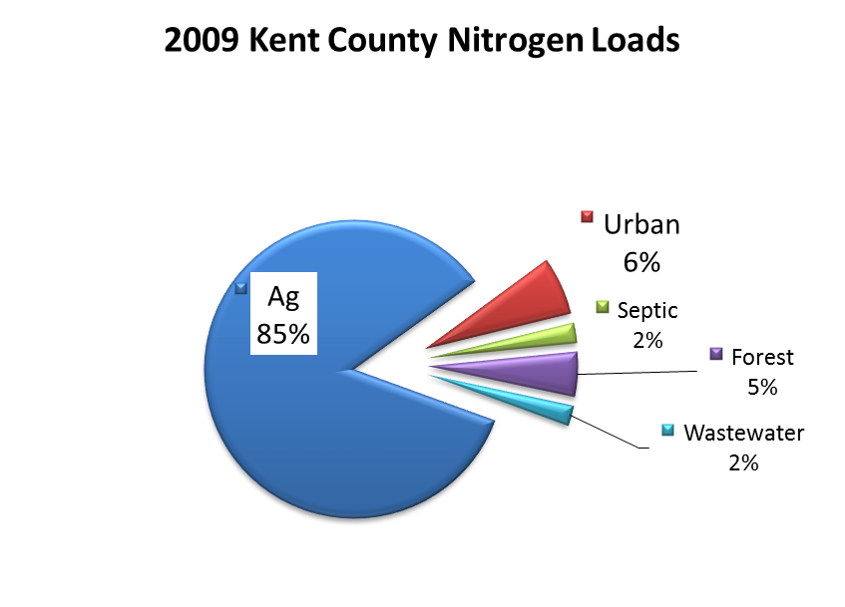
Quantity by Sector

Slide 5
$2 to $10/pound

Slide 6
 | Kent County Total Nitrogen Loads
 | 2009 | 2009 | 2017 | 2017 | 2017 | 2017
 | Current | % of | Target | pound | % | $/ pound
Sector | pounds | Total | pounds | reduction | reduction | reduction
Ag | 1,581,962 | 85% | 1,096,225 | 485,737 | 31% | $5
Urban Stormwater | 116,716 | 6% | 86,758 | 29,958 | 26% | $500 +
Septic | 41,128 | 2% | 27,831 | 13,297 | 32% | $80
Forest | 91,877 | 5% | 92,380 | -503 | -1% | $0
Wastewater | 41,739 | 2% | 47,652 | -5,913 | -14% | $50
Total | 1,873,422 | 100% | 1,350,846 | 522,576 | 28%

Slide 7
Estimated Costs of Watershed Implementation Plans (WIPs)
Cecil County - $600 Million
St. Mary’s County - $900 Million
Washington County - $1.1 Billion
Anne Arundel County - $2 Billion

Slide 8
Estimated Costs of Watershed Implementation Plans (WIPs)
Cecil County - $600 Million
St. Mary’s County - $900 Million
Washington County - $1.1 Billion
Anne Arundel County - $2 Billion
And
At least 7 Counties (including Dorchester) have already signed with the Funk & Bolton Law Firm in an effort that may undermine the whole TMDL Process.

Slide 9
The Good News!
At the same time that Dorchester and many other counties are estimating costs in a range of $600 million to $1 Billion….
Nearby Talbot County estimates that it can comply with the TMDL at a cost of only $60 to $80 million.
IF
MDE will remove the artificial walls and silos separating different BMPs and allow the counties the flexibility to target the most cost-effective solutions.

Slide 10
$2 to $10/pound

Slide 11
 | Kent County Total Nitrogen Loads
 | 2009 | 2009 | 2017 | 2017 | 2017 | 2017
 | Current | % of | Target | pound | % | $/ pound
Sector | pounds | Total | pounds | reduction | reduction | reduction
Ag | 1,581,962 | 85% | 1,096,225 | 485,737 | 31% | $5
Urban Stormwater | 116,716 | 6% | 86,758 | 29,958 | 26% | $500 +
Septic | 41,128 | 2% | 27,831 | 13,297 | 32% | $80
Forest | 91,877 | 5% | 92,380 | -503 | -1% | $0
Wastewater | 41,739 | 2% | 47,652 | -5,913 | -14% | $50
Total | 1,873,422 | 100% | 1,350,846 | 522,576 | 28%

Slide 12
Cost of Complying with Urban Stormwater TMDL Without Trading
29,958lbs@ $500/pound = $15 million/year
29,958lbs@ $5/pound = $150 thousand/year
29,958lbs@ $50/pound = $1.5 million/year

Slide 13
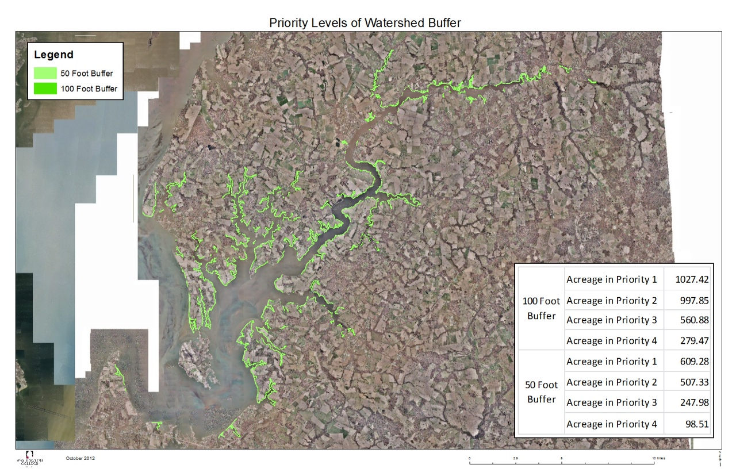
Potential Sites for Switchgrass in the Chester River Watershed

Slide 14
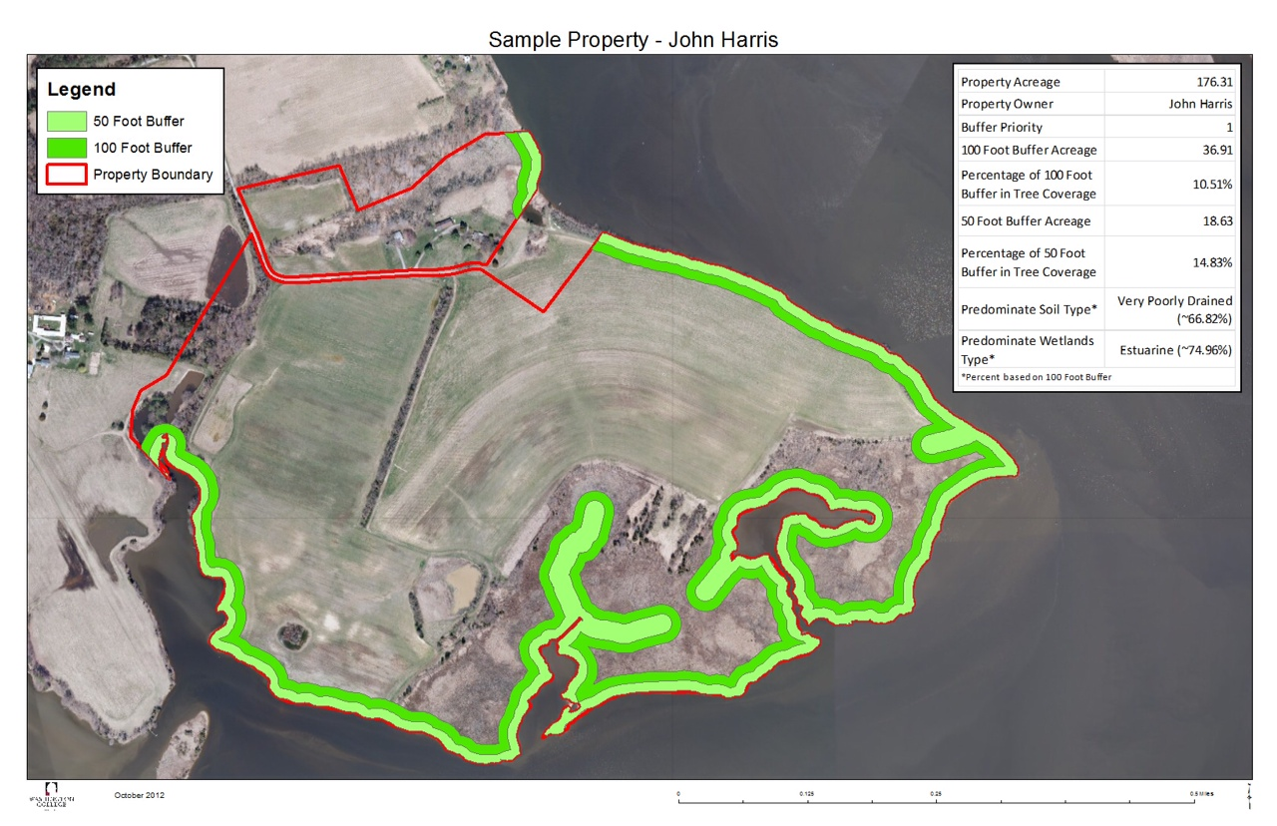
One example of the potential for providing Nutrient Reduction Credits with Switchgrass

Slide 15
The Trading & Offset Policy does not need to become a fiscal cliff If MDE provides reasonable flexibility on Trades. (And Tears Down the Walls between Categories of Nutrient Reductions.)

Slide 16
J. David Foster
Riverkeeper
Chester River Association
400 South Cross St.
Chestertown, Md. 21620
410 708 8244
ChesterRiverkeeper@ChesterRiverAssociation.org

