Slide 1

Understanding the State’s
Accounting for Growth Policy
From a County Perspective
January 3, 2012
Maryland Association of Counties
Annual Winter Conference
Frederick County Office of Sustainability and Environmental Resources
Notes:
Thank MDE for not trying to move forward with the offset policy for Tier III areas at this time, and for taking the time to revisit its proposed offset policy. Also thanks for removing the requirement to offset Vehicle Miles Traveled and loads for forests.
My talk will review the stance of Maryland Association of Counties on the offset policy. Where there are specific regional concerns, I will note them. I will also se examples from Frederick County.
I used the current draft of the regulations with MDE’s updates provided to the Sustainable Growth Commission WIP Workgroup on October 24, 2012 and MD Legislature on Nov 28, 2012.

Slide 2
How are Counties Affected?
As developers of public projects
As promoters of economic development
As proposed guarantors of offset projects
As administrators of various aspects of proposed regulation
As possible administrators of fee-in-lieu funds and projects
As generators of credits
Notes:
As a developer, the Counties will be subject to fees and offset requirements on public projects the same as under any project
Because the fees for offsets are so high, in some counties they may slow or halt economic development activity.
The current thinking of MDE is to make the Counties responsible for offsets after 30 years, which we will discuss later. There are also discussions at MDE to make counties responsible for offsets should the entities that hold them fail.
As counties do the intake for development projects, they will be administering the application process for offsets. It is unclear what responsibilities the counties will have beyond this. For example, there are questions about the level of verification MDE will expect of Counties for proposed offsets.
The state has proposed that funds from the Fee-in-lieu will go to the Bay restoration fund, but this could have negative impacts on local water bodies. Counties have proposed first right of refusal on these monies. Counties are also being asked through industrial discharge permit renewals to provide credit opportunities for retrofits. The role of counties in a credit market will need to be defined.

Slide 3
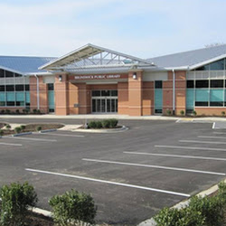
Fee-in-Lieu Case Studies
Brunswick Library
LEED Silver Certified
1.5 acres, 15,376 square foot building
In municipality, on ENR WWTP
Requires 0 lbs offset for wastewater, 10 lbs for stormwater (50% reduced for ESD treatment at 5 lbs).
5 lbs N remaining to be offset
Notes:
Recently built, real numbers used for example to predict similar future projects.

Slide 4
Brunswick Library
Total cost before offsets: $1.6M
$15K
MDE has stated price will likely be between $2000-$3000 per pound N which would cost this library $10K-$15K for fee
$10K

Slide 5
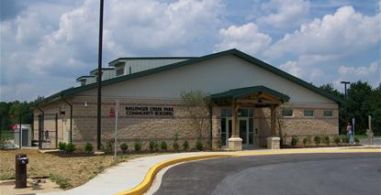

Fee-in-Lieu Case Studies
Ballenger Creek Community Building and Dog Park
55.8 acres, 5,314 square foot building
In rural area, on BNR WWTP
Requires 0 lbs offset for wastewater, 302 lbs for stormwater (50% reduced for ESD treatment at 151 lbs).
151 lbs N remaining to be offset

Slide 6
Ballenger Creek Bldg and Dog Park
Total cost before offsets: $2.9M
$453K
MDE has stated price will likely be between $2000-$3000 per pound N which would cost this dog park $301K-$453K for fee
$301K

Slide 7
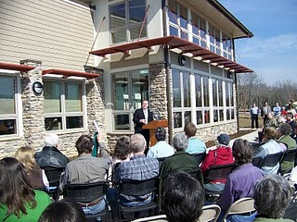
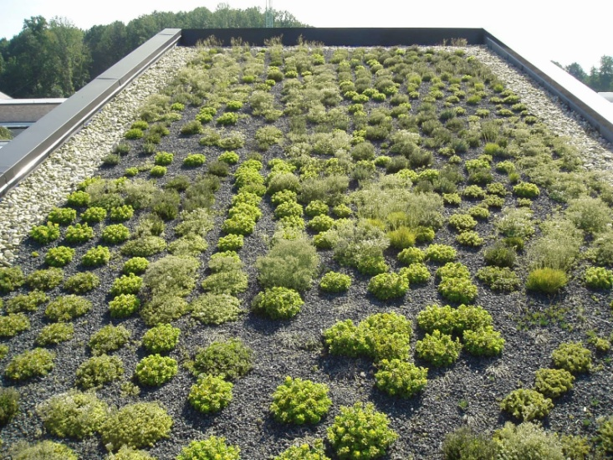
Fee-in-Lieu Case Studies
Catoctin Creek Nature Center
Green construction, green roof
138.2 acres, 6,084 square foot building.
In rural area, on conventional septic
Requires 493 lbs offset for septic, 748 lbs for stormwater (50% reduced for ESD treatment at 374 lbs)
867 lbs N remaining to be offset

Slide 8
Catoctin Creek Nature Center
Total cost before offsets: $2.9M
$2.6M
MDE has stated price will likely be between $2000-$3000 per pound N which would cost this nature center $1.7M-$2.6M for fee
$1.7M

Slide 9
Fee-In-Lieu
Having a fee-in-lieu option is important
Cost of fee is just as important. $2000-$3000 proposed by MDE
If MDE adds offsets for phosphorus as it has proposed, will have additional costs
Notes:
The Chesapeake Bay Commission report on cost effectiveness of trading suggests Phosphorus costs significantly more per pound to remove than nitrogen.

Slide 10
Fee-In-Lieu
Jurisdictions should have first right of refusal on fees collected rather than to the Bay Restoration Fund as proposed by MDE.
If fees go to the Bay Restoration Fund, local water bodies with impairments will become further impaired.

Slide 11

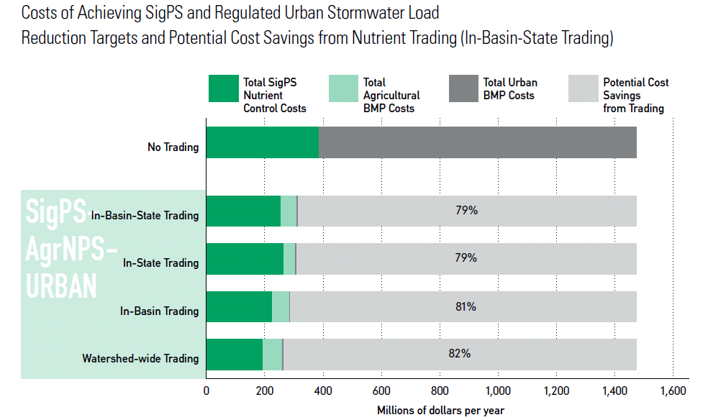
Trading
Trading can save 79%-82% of costs to reduce pollutants between WWTPs, Ag, and Urban.
Geographies must be > in-basin-state. MACo is proposing same.
Some counties want right to limit trading in boundaries
MDE and EPA won’t allow trading outside of an impaired water body but this eliminates trades
Example provided for illustration. Urban offset trades from new development not included in Chesapeake Bay Commission report.
Notes:
One entity needs to reduce pollution, the other can provide the reduction, and the reduction is sold at market price based on demand.
May 2012 Chesapeake Bay Commission Report looked at potential savings from trading. Note that it included retrofit costs but not new development.

Slide 12
Applicability of Offsets
Draft regulation proposes offsets on one acre and greater.
MDE is proposing to require offsets for land disturbances of less than 1 acre.
MDE’s proposed 5,000 square feet of disturbed land could capture basic home renovations, triggering a substantial cost for a project that is not actually creating new growth.

Slide 13
Offset Loads, Redevelopment
Developer should not be required to address nutrient and sediment runoff that existed on the land prior to the new development
Requires reductions rather than setting a pollution cap
Source of major expense

Slide 14
Responsibility
Local governments should not have to take over responsibility for maintaining offsets after a 30-year period. MACo is opposed to requirement.
Implicitly makes counties responsible for total replacement cost of practices after 30 years.
Some counties want to take over O&M. Should be voluntary.
Counties should not be guarantor if broker/aggregator fails.

Slide 15
Responsibility
Costs below are from King and Hagan study commissioned by MDE for use with local Watershed Implementation Plans
Repeat cost every 20 years.
BMP Name | BMP Unit Cost per Impervious Acre Treated for 20-yr Life Cycle
Bioretention/raingardens* | $217,370
Bioswale | $62,620
Dry Detention Ponds and Hydrodynamic Structures | $112,620
Dry Extended Detention Ponds | $97,120
Impervious Urban Surface Reduction | $163,957
MS4 Permit - Stormwater Retrofit | $97,120
Urban Filtering Practices | $88,620
Urban Forest Buffers | $57,207
Urban Infiltration Practices | $84,370
Urban Tree Planting: Urban Tree Canopy | $207,207
Vegetated Open Channel - Urban | $38,207
Wet Ponds and Wetlands | $4,063
Urban Stream Restoration/Shoreline Erosion Control | $82,320

Slide 16
Local Concerns
“MACo cannot support an AFG policy that would effectively halt growth in rural areas or destroy the viability of redevelopment projects in urban areas”:
  Local delivery rates for some basins are extremely high in the Bay Model due to high background rates, multipliers, correction factors. Impact to counties varies
  If MDE is not consistent about using same method for determining loading rates between development calcs and offset calcs, it penalizes counties with lower delivery ratios

Slide 17
Local Concerns
  Counties with little economic development expect growth to halt
  Counties with rural development pattern, low densities, areas without redevelopment and infill potential expect economic development to be heavily impacted
  Policy disincentivizes redevelopment projects in urban areas as illustrated by MD Builders on a green housing project with increased density

Slide 18
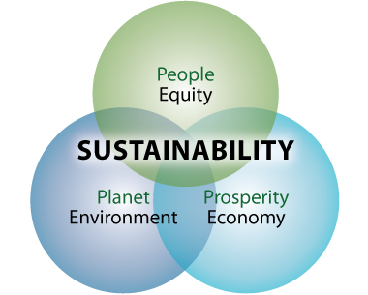
Thank You!
Shannon Moore
301.600.1413
smoore@frederickcountymd.gov

