Slide 1
MAXIMIZING PUBLIC INVESTMENTS: GETTING MORE BANG FOR THE TAXPAYER BUCK
Kathryn L. Hewitt, CPA, CCM, CPFO
Treasurer, Harford County, Maryland

Slide 2
What funds are we discussing?
    Operating cash/pooled cash
    Capital projects
    Rainy day funds
    NOT PENSION FUNDS

Slide 3
Authority and Statutes?
Annotated Code of Maryland: Article 95 Section 22
State Finance and Procurement Article Section 6-222 and 6-202
County Charters/Codes
Investment Policies

Slide 4
What are the common types of Securities for our investments?
U. S. Treasuries
U. S. Agencies
Repurchase Agreements
Certificates of Deposit (collateralized
CDARS
MLGIP
MMMFs
Commercial Paper and Bankers Acceptances

Slide 5
Authority and Statutes
Annotated Code of Maryland: Article 95 Section 22
State Finance and Procurement Article
County Charters/Codes
Investment Policies

Slide 6
Basic Tenants
Preservation of Capital
Safety & Security
Liquidity
Diversification

Slide 7
Basic Tenants (continued)
Management of Risk
  Safekeeping
  Credit Quality
  Counterparty
  Maturity
Competitive Bidding
Earning a competitive rate of interest
Benchmarking

Slide 8
How can we maximize our investment return?
Understand your cash flows

Slide 10
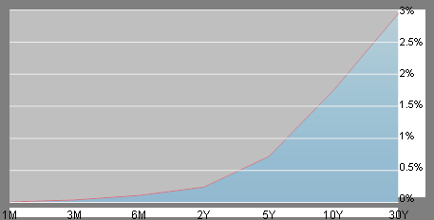
U. S. Treasury Interest Rates

Slide 12
How do we use a normal yield curve to maximize our yields?
Daily cash investments – look for cash flow “holes” and fill them
Core portion – make a strategy to invest longer maturities – one method is to ladder maturities; another is to barbell

