Slide 1
Cecil County Public Schools The Nuts and Bolts of School Budgeting
Maryland Association of Counties
January 3, 2013

Slide 2
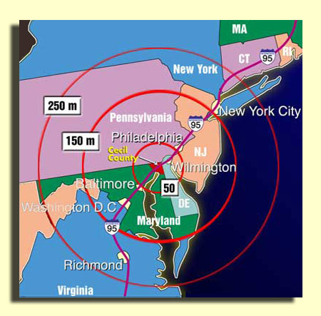

Cecil County At the Head of the Bay
360 square miles
Population 107,000
Most rural county on the I-95 corridor between Virginia and Boston, Ma.
Changing to Charter form of government
County executive
Five district council members

Slide 3
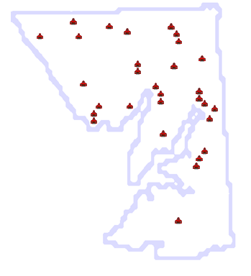

Cecil County Public Schools
14th largest of the 24 MD LEAs in total enrollment
Largest school system on the Eastern Shore
19th in cost spent per student
18th in county wealth per student
24th in transportation cost per student
19th in non-instructional staff to student ratio
6th highest Return on Investment in Education
Local economic impact of education spending - 135% return on investment

Slide 4
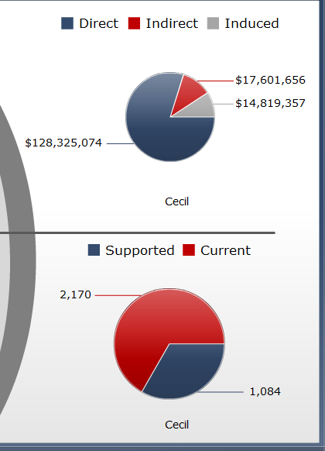
Return on Education Investment
Total Economic Impact | $ 160,746,094
Jobs | 3,254
ROI | 135%
Economic Benefits
Type 1 Tangible - direct
Trained and trainable workforce with higher earnings potential and improved quality of life
Type 2 Tangible – indirect
Private sector economic, employment and fiscal impact
Type 3 – Intangible
Attract and retain families with skilled and/or professional workers, increasing assessable base

Slide 5
Budget Timeline
1/09/2013 | Administrative Services Budget
1/23/2013 | Education Services Budget
1/28/2013 | Budget Hearing
2/11/2013 | Board of Education Adopts Budget
3/1/2013 | County Executive Submits Budget to County Council
5/21/2013 | County Council Adopts Budget

Slide 6
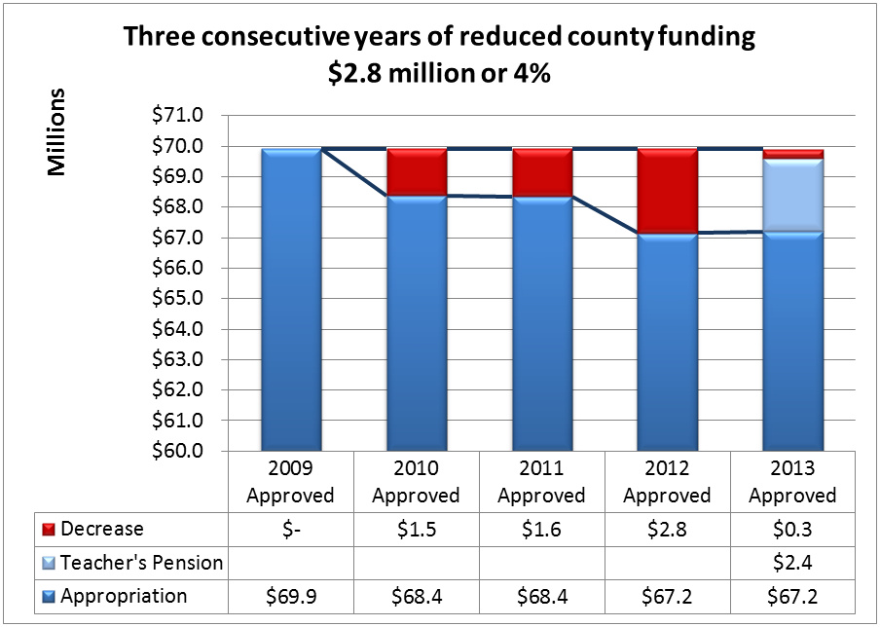
MOE Adequate Funding
Notes:
Enrollment declines 2.8% 463 students from 2009 across 28 schools 13 grades

Slide 7
County Investment in School Facilities
Outstanding bond principal declined from $111 million in 2006 to $65.4 million ending 2013.
Notes:
5 superiors on school inspections last year
No major addition/renovation project approved since 2005

Slide 8
Collaboration with Departments and Agencies
Procurement
Supplies (CC Gov, C College)
Fuel Oil (C College)
Propane (CC Gov, C College)
ESMEC Energy Trust ( CC Gov., C College, Library, Town of Elkton)
Group Term Life Insurance (CC Gov.)
Healthcare consultant (CC Gov.)
457b Retirement Savings Plan (CC Gov.)
Partnerships
Health Department
Social Services
County and Municipal Law Enforcement
Economic Development Commission
Use of facilities (C College, Parks and Recreation)

Slide 9
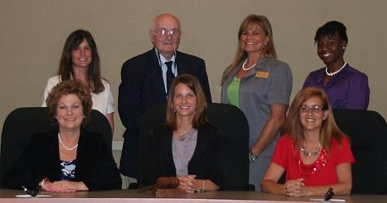
Cecil County Board of Education
Lauren Camphausen, President
Donna Zane, Vice President
Dawn Branch, Member
William Manlove, Member
Wendy Wintersgill, Member
D’Ette Devine, Ed.D., Superintendent
Chanelle Jones, Student Member
Board Practices
Relationships
Communication and Education
Transparency and Commitment

Slide 10
RELATIONSHIPS - Internal
Most Essential Relationship = Board of Ed Members
Year-round focus on building the internal team:
Trust, Honesty, Respect, Support
All members have input and are heard
Commitment to respectful consensus
After consensus ➔ UNITED FRONT
Understanding the Board’s Role:
All members understand and respect their role vs. the role of the Superintendent
Members grant autonomy to Superintendent to focus on the day-to-day and commit their energy to the “big picture”

Slide 11
RELATIONSHIPS – Local Gov’t
Build Relationships Beyond “Budget Season”
Invite local government officials to school system events and celebrations
Personally conduct school and facility tours
Attend local government meetings and special events
Stay informed of other issues/priorities within our county
Contact regularly with local officials to “check in”
Remain fully educated on the entire county budget
Fully understand the structure and components
Aware of competing priorities/needs
Understand county budget trends and history
Stay aware of forecasts and potential issues (including state and federal)

Slide 12
Communication and Education
Budget documents/information are readily available and easily accessible
Regular e-mails and phone calls to local government officials to share education-related research, articles, documents
Press releases, podcasts, e-mails, letters, and memos to keep staff and community informed
Board Educates:
Proactively
Community Forums
Presentations to civic orgs, political groups, PTO/PTA, etc.
News articles, letters to the editor, information on website
Passively
Corrects misinformation while out in the community
Members make themselves accessible and available for questions

Slide 13
Transparency and Commitment
Engage community in the budget process
Community Forums (twice per year)
All budget work sessions/hearings are open to the public and allow opportunity for public comment
Be visible and accessible
Attend community functions beyond the school system
Accept all invitations to speak to community groups and organizations about the school system
Respond promptly to e-mails/correspondence

Slide 14
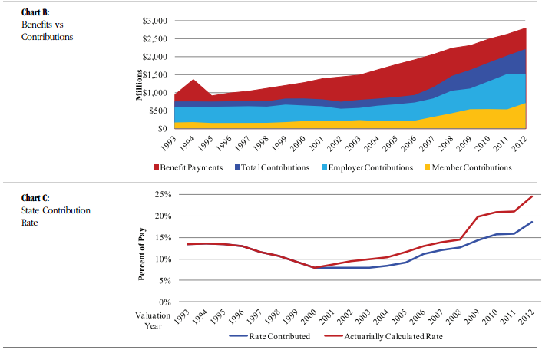
State Teachers’ Pension What’s next?
From – Maryland State Retirement and Pension System Fiscal 2012 CAFR

Slide 15
State Teachers’ Pension What’s next?
Normal Pension Cost – Benefits earned by active employees
Paid by BOE
2012 reform lowered benefits for new employees
UAL – The unfunded actuarial liability to pay future benefits
Paid by the State
Effected by net asset value and rate of Investment Return
Corridor
Introduced in 2002
Proposed legislation during the 2013 General Assembly session to phase out over ten years

