Slide 1
MACO 2013 General Session
“Open Government: What We Owe Our Citizens”
County Executive Isiah Leggett
Montgomery County Maryland
January 3, 2013

Slide 2
Agenda
Challenges Facing County Governments
Possible Solutions
Montgomery County’s Digital Government Strategy
openMontgomery
Principles
Four Pillar Programs
Digital Government Strategy References
Counties Open Government Partnership Proposal
Demonstration

Slide 3
Challenges Facing County Governments
Era of great change
Globalization
Economic uncertainty
Social need
Technology evolution
Need to be transparent, accountable, inclusive and economically vibrant
Need for government to partner with its communities to meet the challenges and sustain government programs and economic vitality
Question: Not “Can County government keep pace?” but “How can County government keep pace?”

Slide 4
Possible Solutions
Strengthen/formalize/connect open government programs for transparency, openness, accessibility and collaboration.
Review Digital Strategy to go beyond open web pages and social media.
Consider:
Opening government data
Public consultation
Extension of services to consumer
Information aggregation
Analytics and performance management

Slide 5
Montgomery County’s Digital Government Strategy
Pass Open Data Legislation
Collect and manage open data
Publish high value datasets from all parts of government
Publish MPIA requests and responses
Publish a Digital Government Strategy and Roadmap http://montgomerycountymd.gov/open/Resources/Files/openMontgomery_Digital_Government_Strategy_and_Roadmap_2012-12-05.pdf
Strengthen/formalize/connect open government programs
Repackage
Learn for other’s experience
Long-term: consider a strong Counties Open Government Partnership

Slide 6
openMontgomery Launch
openMontgomery Video

Slide 7
openMontgomery Principles
Base Open Government programs on four key principles:
Customer centricity
Information centricity
Platform sharing
Security and privacy
Program considerations:
Leverage existing systems, infrastructures and technology investments
Encourage use of shared platforms (e.g., cloud solutions)
Consider “crowd-sourcing” (civic participation in solutions identification and development)

Slide 8
openMontgomery Pillar Programs
Four pillar programs performing collectively
dataMontgomery
https://data.montgomerycountymd.gov/
mobileMontgomery http://www.montgomerycountymd.gov/open/mobile.html
engageMontgomery http://www.montgomerycountymd.gov/open/engage.html
accessMontgomery http://www.montgomerycountymd.gov/open/mobile.html

Slide 9
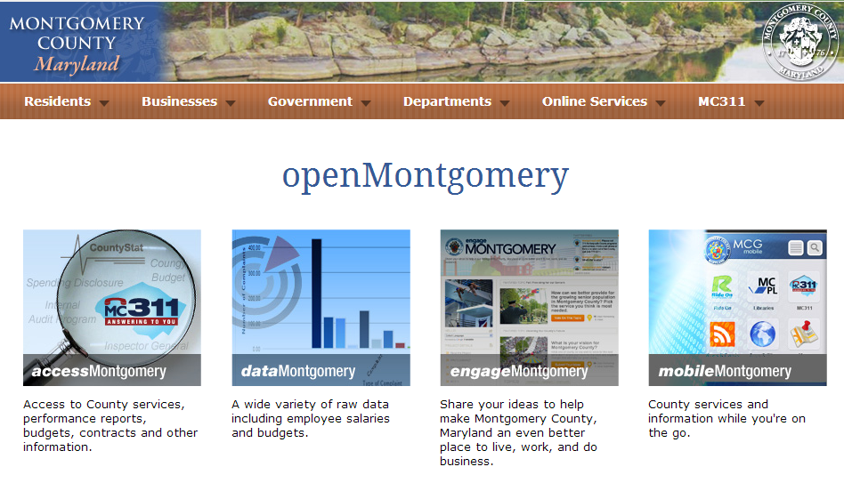
Open Montgomery

Slide 10
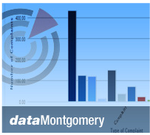
dataMontgomery
High value County datasets
Consumable format (aggregate, federate, consolidate)
View and analyze raw data
Use for educational, civic, research, commercial and other purposes to extend County services

Slide 11
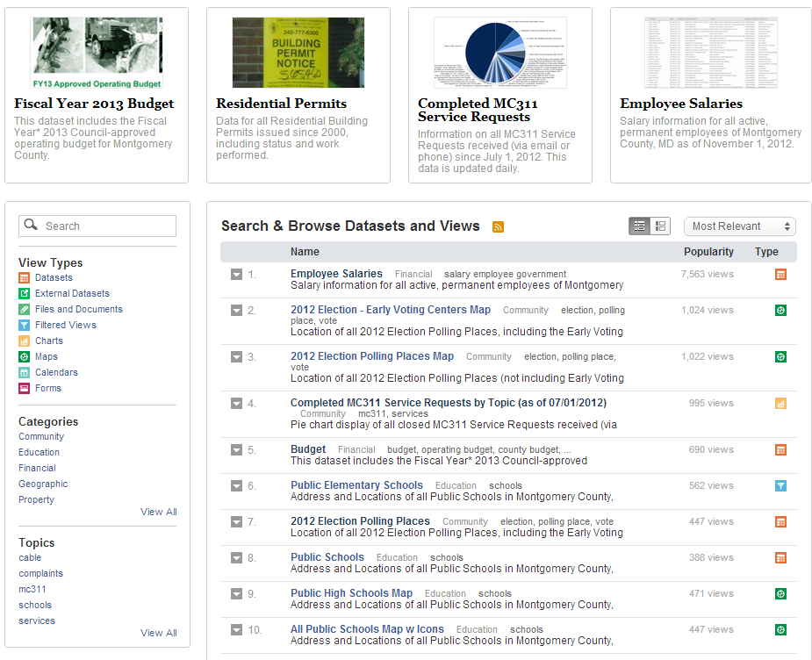
dataMontgomery

Slide 12
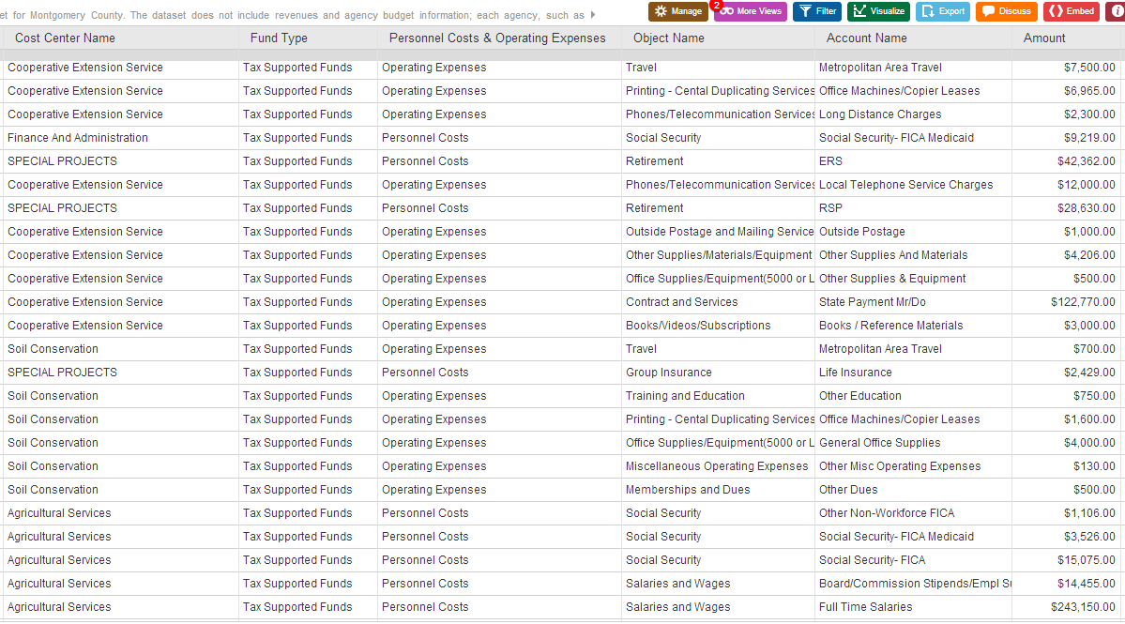
dataMontgomery

Slide 13

accessMontgomery
MC311
CountyStat reports on departmental and program performance
Internal audit reports
Inspector general audits and reports
County budgets
Spending disclosures
Open solicitations for proposals and contracts
Search County contracts
County and other public facilities where free Wi-Fi access is available

Slide 14
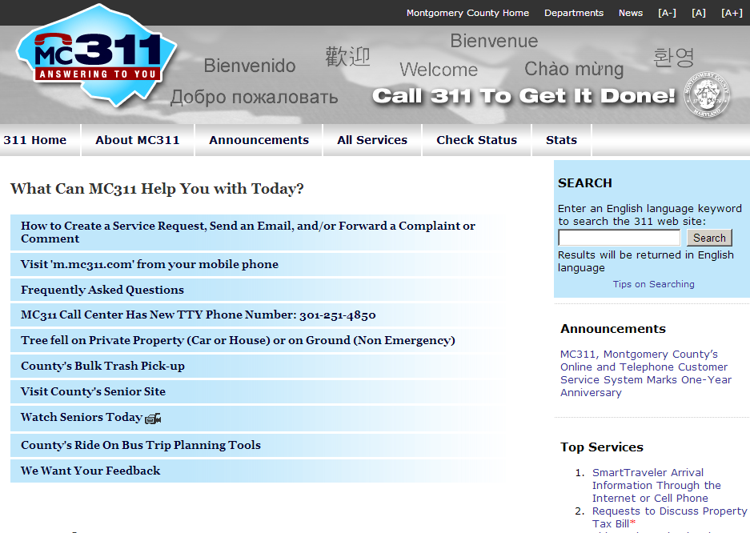
accessMontgomery

Slide 15

engageMontgomery
Montgomery County On-Demand
Social media channels
Public consultation forums (Town Halls) by topics of interest
Gather feedback
Gauge sentiment, support and concerns
Solicit solutions, ideas drive change in this county for the better
Use to plan ‘in-person’ Town Halls

Slide 16
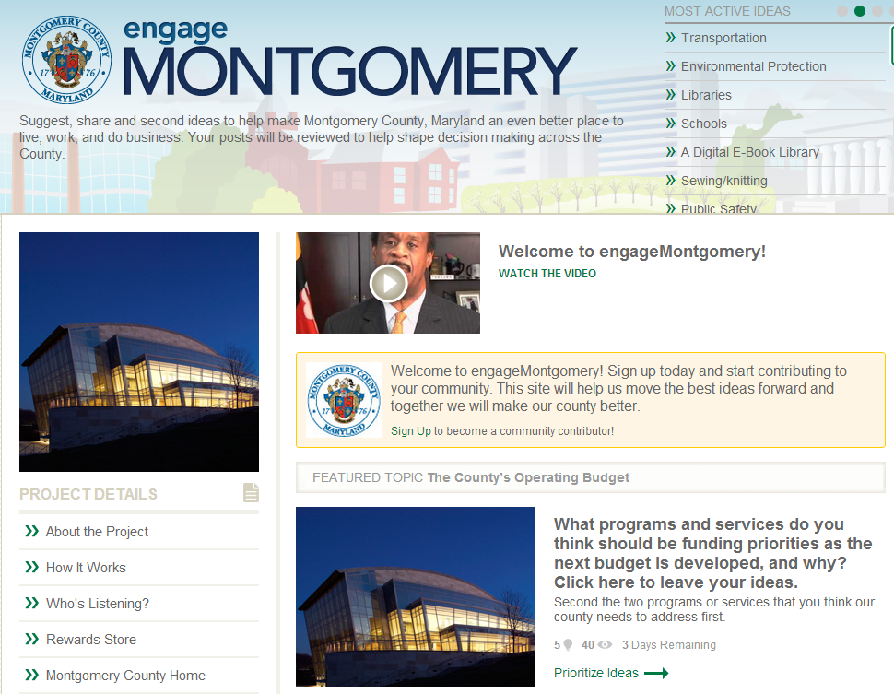
engageMontgomery

Slide 17
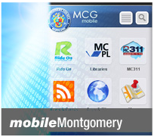
mobileMontgomery
“On-the-Go” mobile access to County services and information:
MC311 Service Requests and Status
RideOn Bus schedules and arrival times
Library services
Alerts, news and calendars
County mobile sites
Geographic information on County services

Slide 18
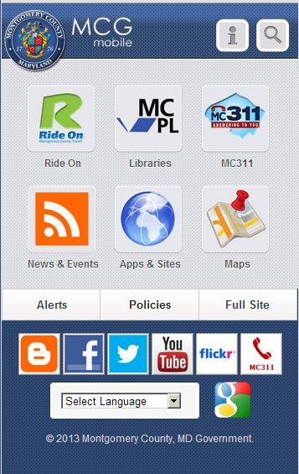
mobileMontgomery

Slide 19
Digital Government Strategy References
Digital Government Strategy Document http://montgomerycountymd.gov/open/Resources/Files/openMontgomery_Digital_Government_Strategy_and_Roadmap_2012-12-05.pdf
Open Government Legislation
http://www6.montgomerycountymd.gov/content/council/pdf/agenda/cm/2012/121126/20121126_GO2.pdf
openMontgomery Video
http://montgomerycountymd.gov/open/media.html

Slide 20
Counties Open Government Partnership Proposal
Objectives
To provide a forum for the identification and sharing of practices and experiences in improving government transparency, service efficiency and effectiveness, community engagement and collaboration, public-private service coordination, and economic development.
To build an ecosystem of open county governments and open government practices that all NACo member counties can share, exchange, and advance to innovative and improve government services and the quality of life in their communities.

Slide 21
openMontgomery
Demonstration

