Slide 1

Common Core in Maryland
January 4, 2013

Slide 2
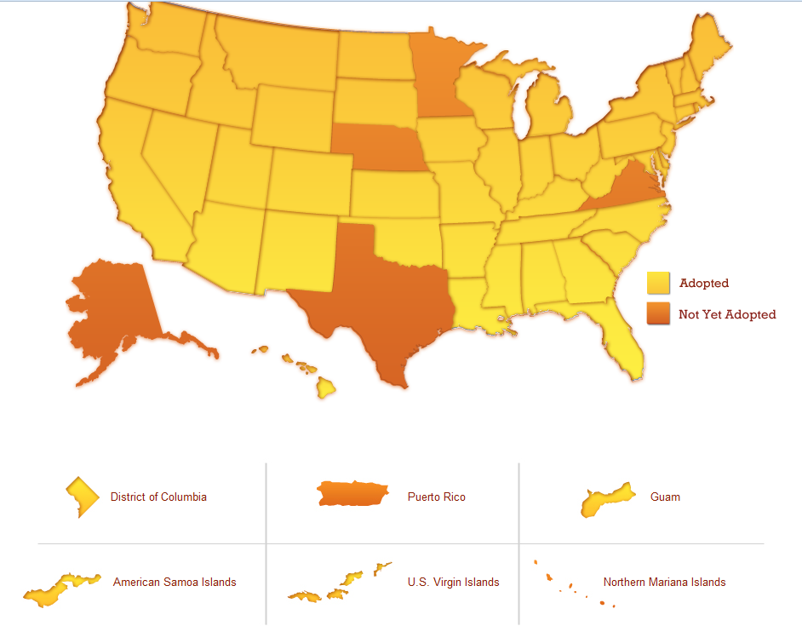
What is Common Core?
A set of high-quality academic expectations that were created through a state-led initiative and have been adopted by more than 40 states.
Source: www.corestandards.org

Slide 3
How is Common Core different?
PARCC Assessments
  Full implementation in school year 2014-15
Shifts in English and Language Arts
Shifts in Math

Slide 4
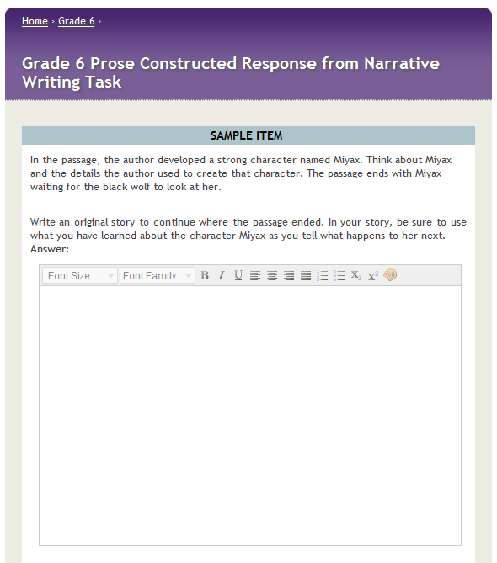
ELA assessment questions
Task types
  Literature Task
  Narrative Task
  Research Simulation Task

Slide 5
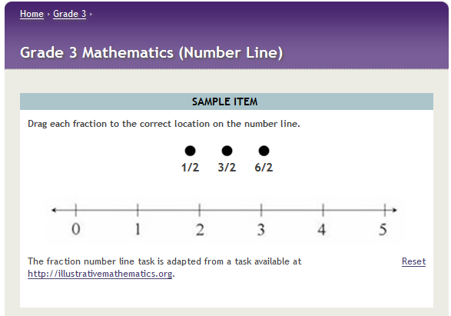
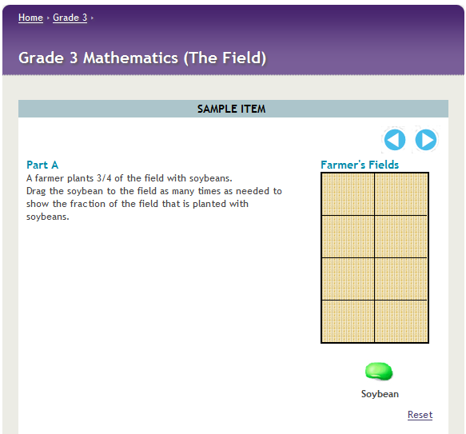
Math assessment questions
Task types
  Type I: Tasks assessing concepts, skills and procedures
  Type II: Tasks assessing expressing mathematical reasoning
  Type III: Tasks assessing modeling/applications

Slide 6
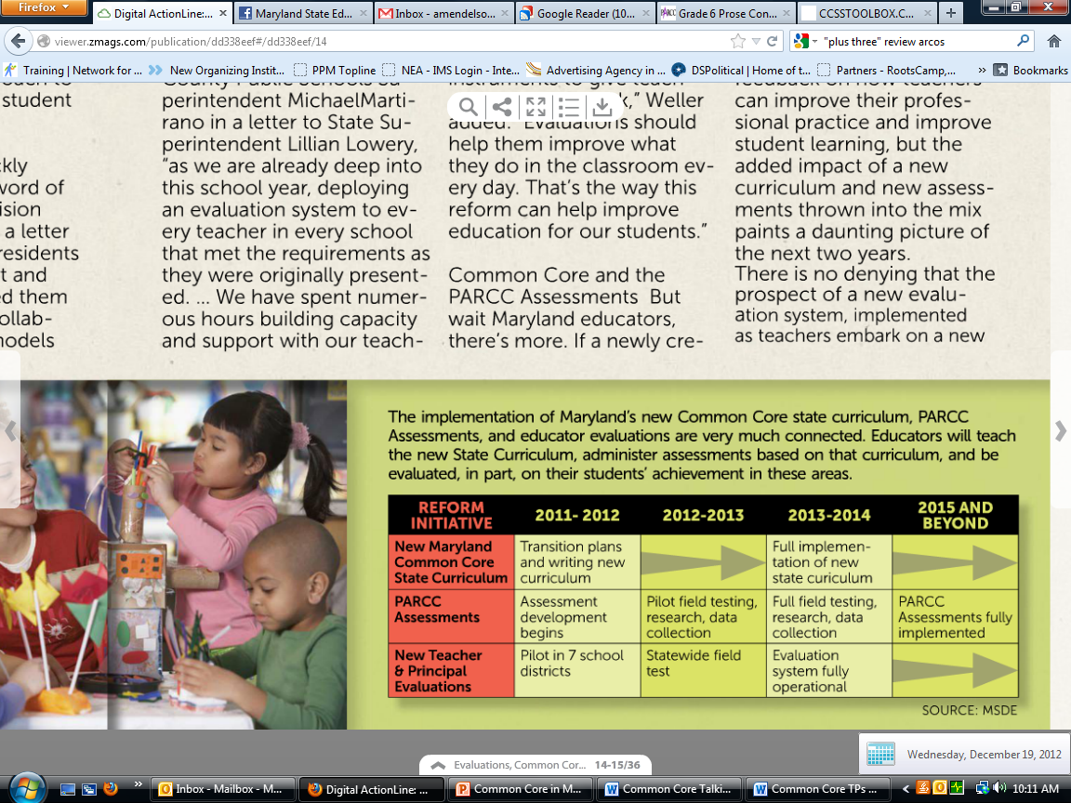
Common Core in Maryland and alignment concerns

Slide 7
Other concerns
Likely dip in student test scores
Adequate resources
Adequate professional development

Slide 8
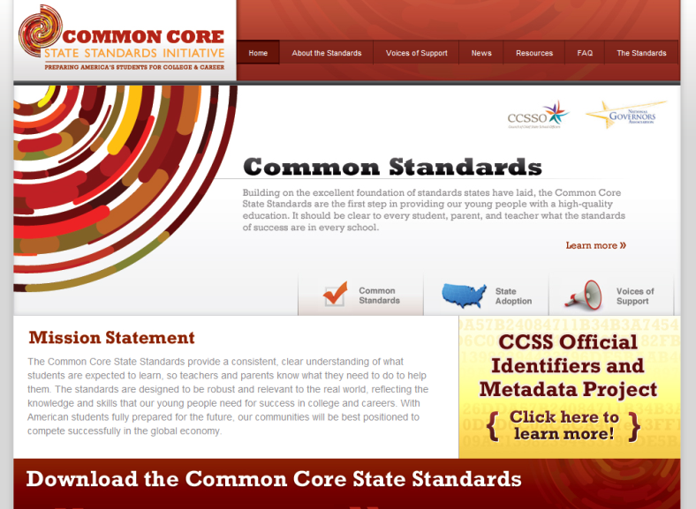
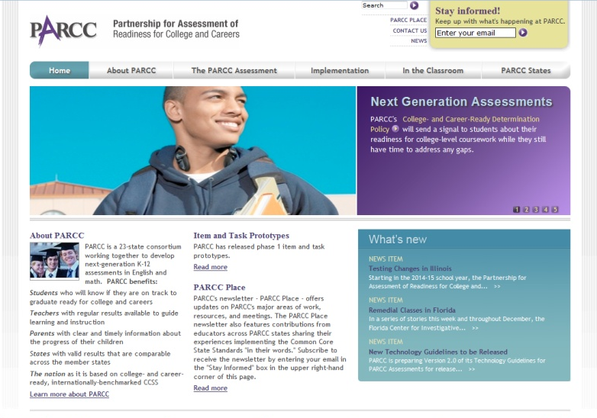
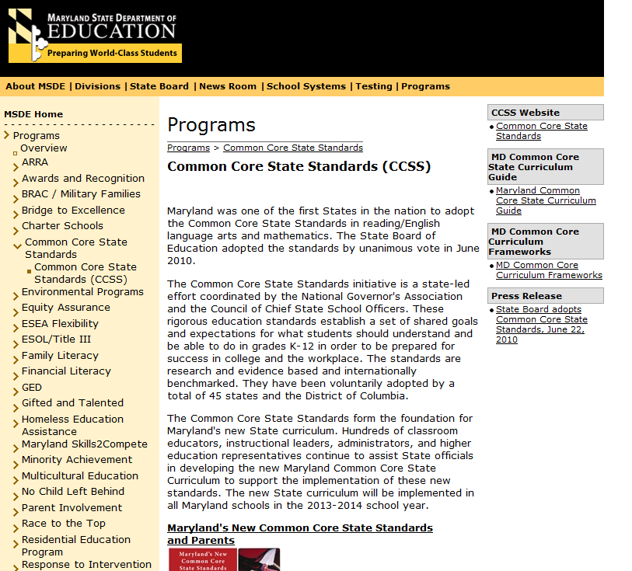

For more information…
Corestandards.org
Parcconline.org
Marylandpublicschools.org
Marylandeducators.org

